Slide 1
期末考 takehome
111032552 林耕生

Slide 2
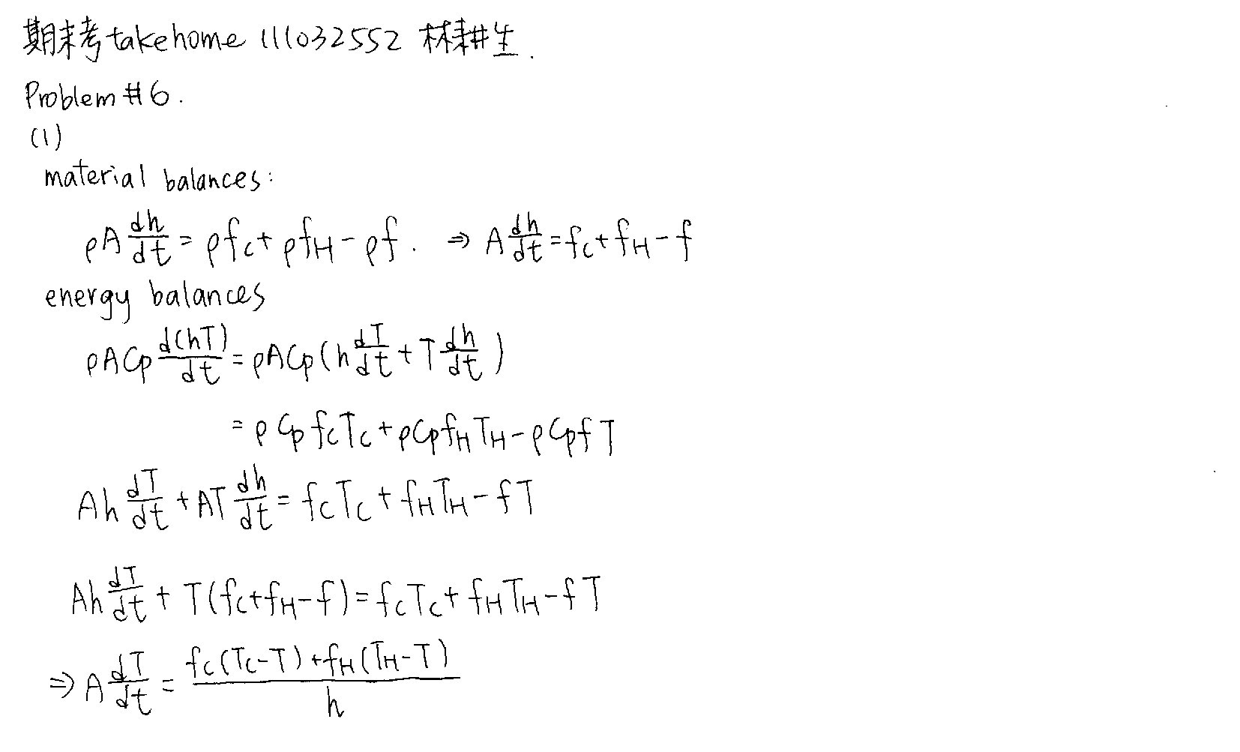

(1)
$$f=C_{v}\sqrt{h}$$
$$3.5=C_{v}\sqrt{4}$$
$$f=1.75\sqrt{h}$$

Slide 3
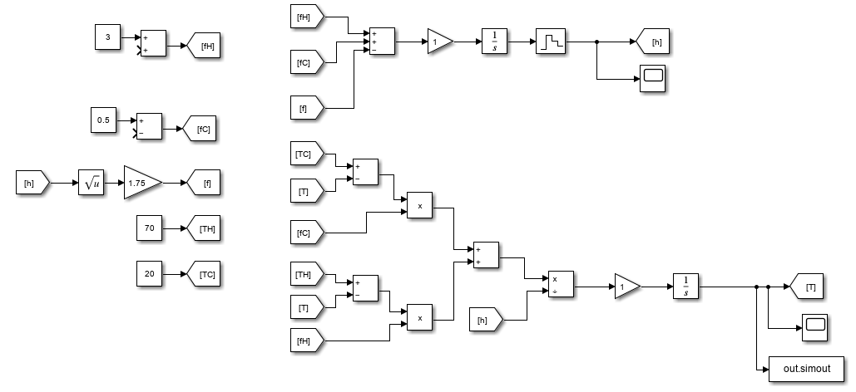
(2)

Slide 4

(3)
$m_{1}=f_{H}$
$m_{2}=f_{c}$
$c_{1}=h$
$c_{2}=T$

Slide 5
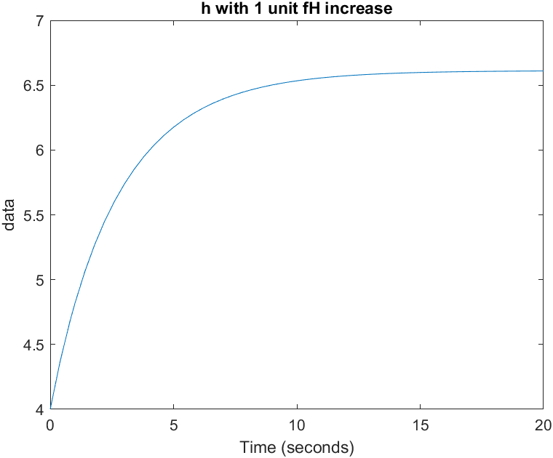
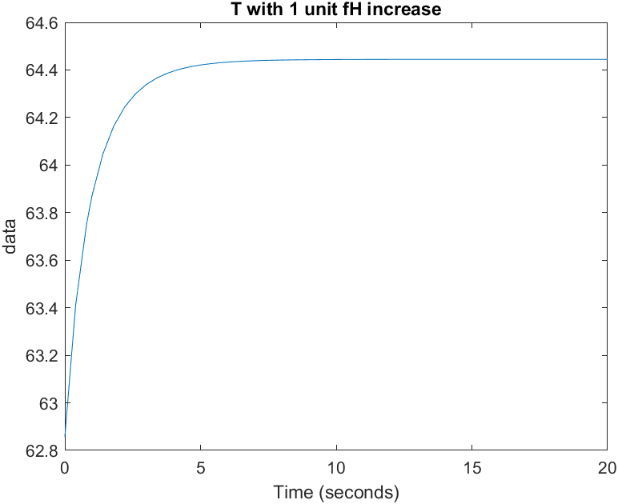


Step test
${Gain}_{11}=6.6$
$τ_{11}=3$
$G_{11}=\frac{6.6}{3s+1}$
${Gain}_{12}=1.64$
$τ_{12}=0.8$
$G_{12}=\frac{1.64}{0.8s+1}$

Slide 6

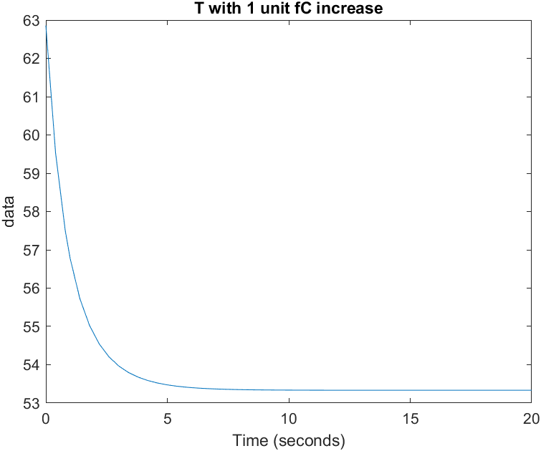


Step test
${Gain}_{21}=6.6$
$τ_{21}=3$
$G_{21}=\frac{6.6}{3s+1}$
${Gain}_{22}=-9.5$
$τ_{22}=0.8$
$G_{22}=\frac{-9.5}{0.8s+1}$

Slide 7
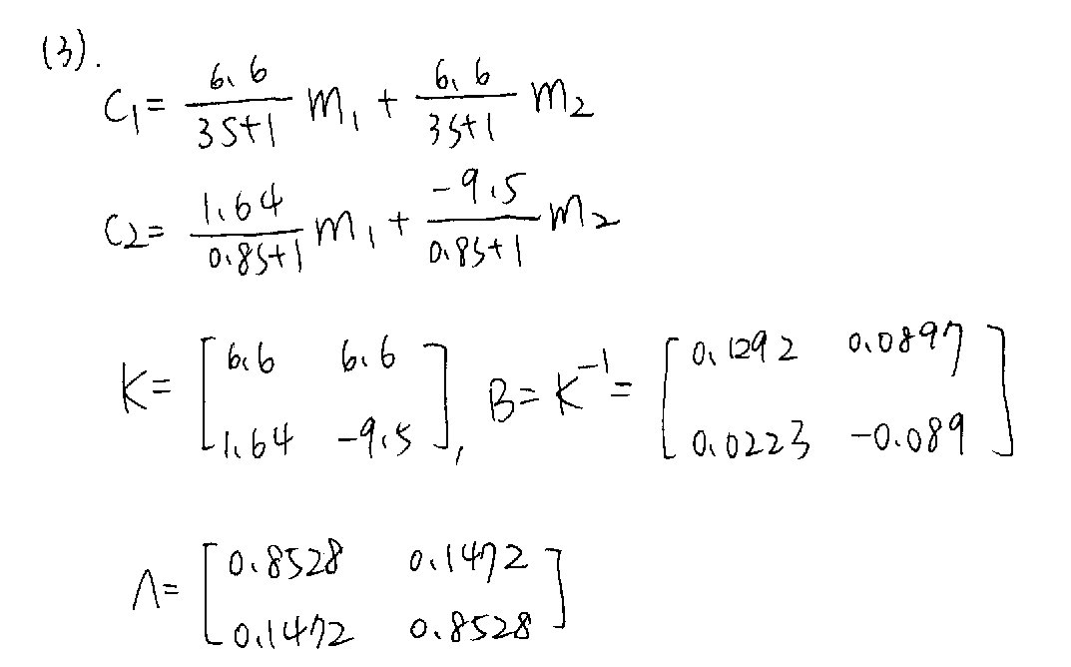

Pair $m_{1}→c_{1},m_{2}→c_{2}$

Slide 8
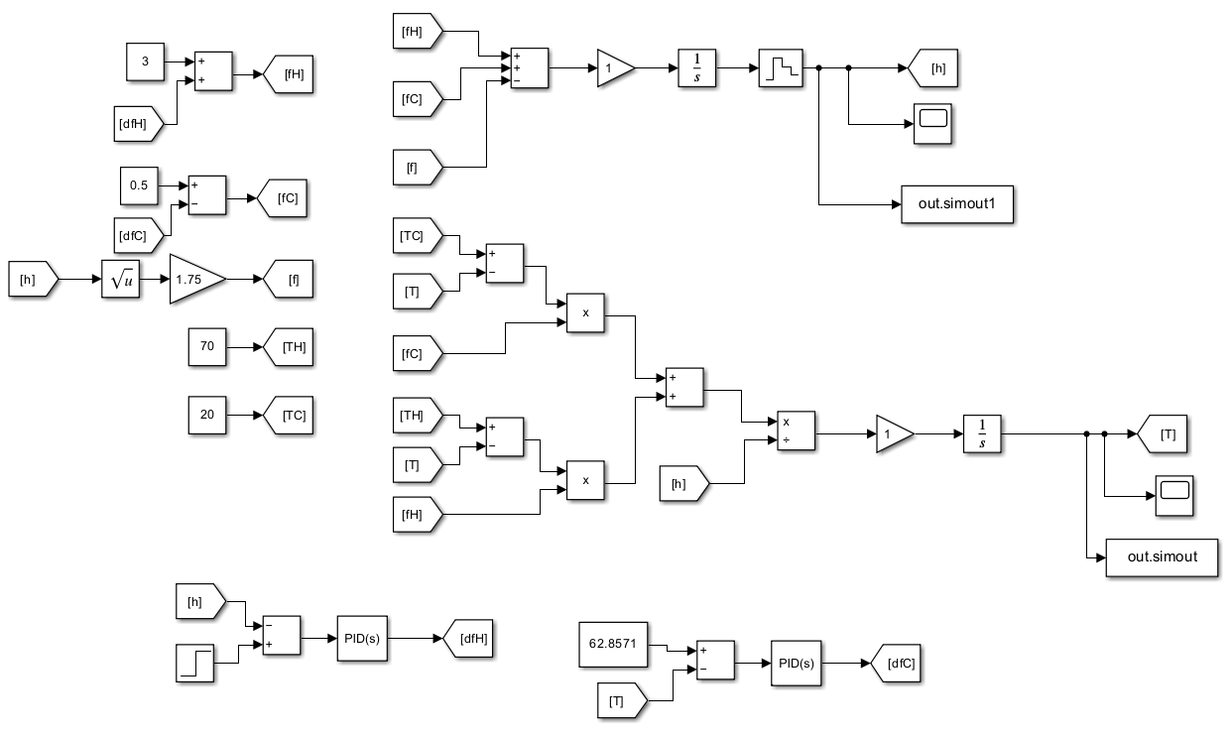

Slide 9
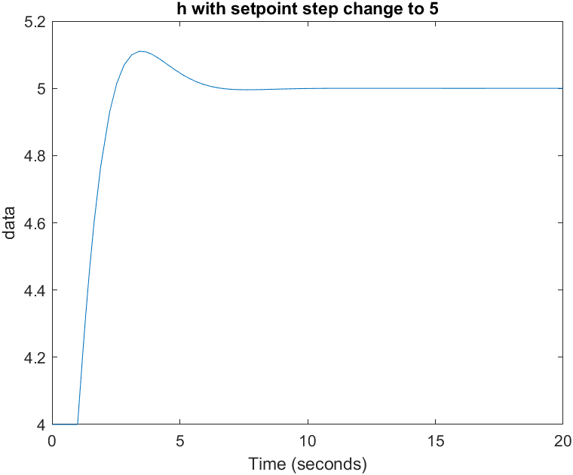
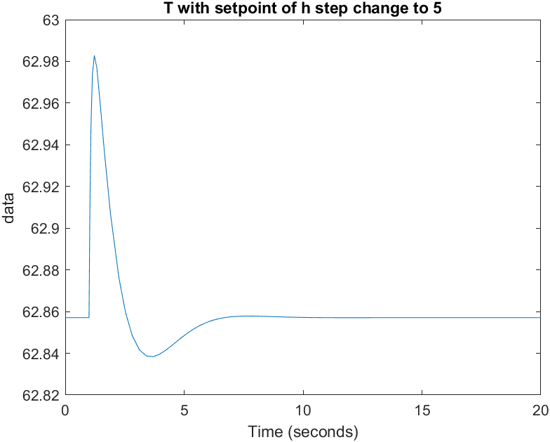
Multivariable system

Slide 10
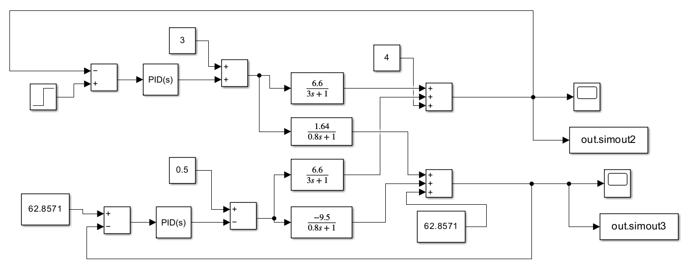
(4)decoupling

Slide 11
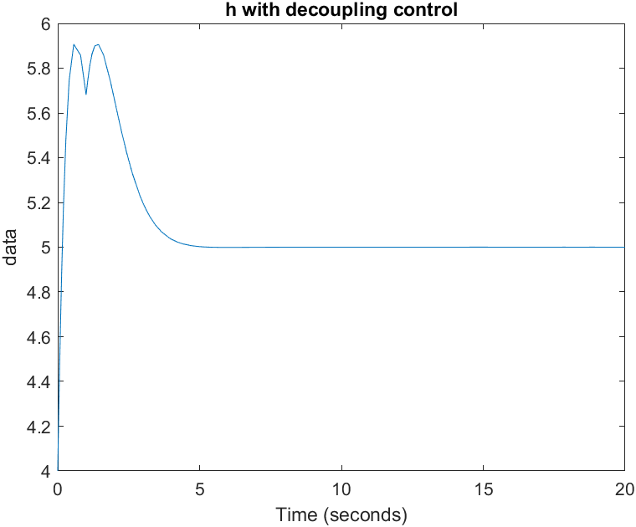
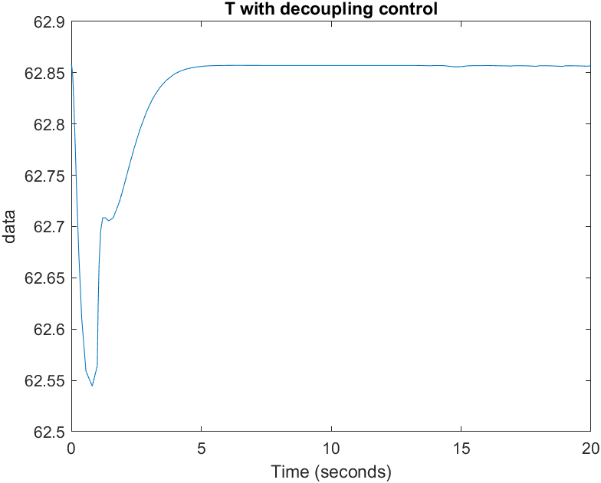
(5)Decoupling control

Slide 12
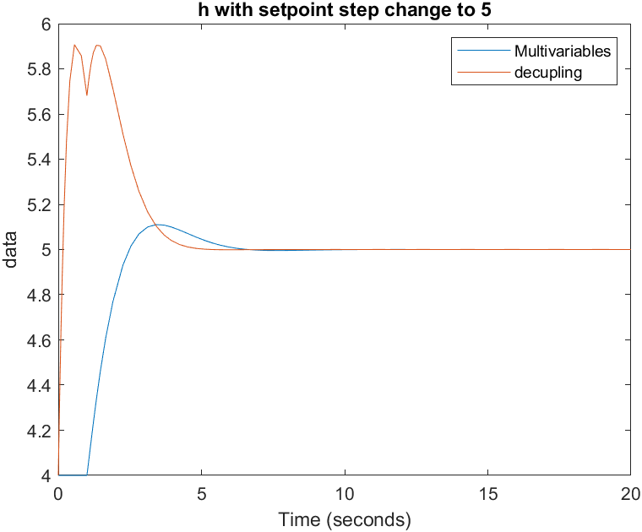
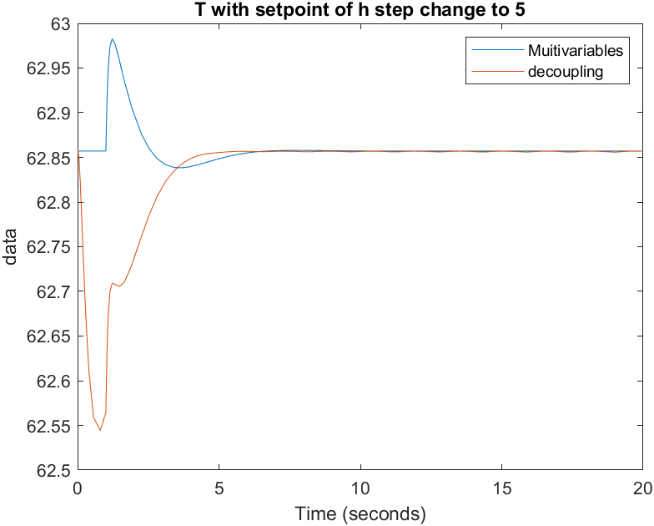
(6)

Slide 13
Compare
Multivariables control smoother
Decoupling control faster

